Slide 1
Uncertainty

Slide 2
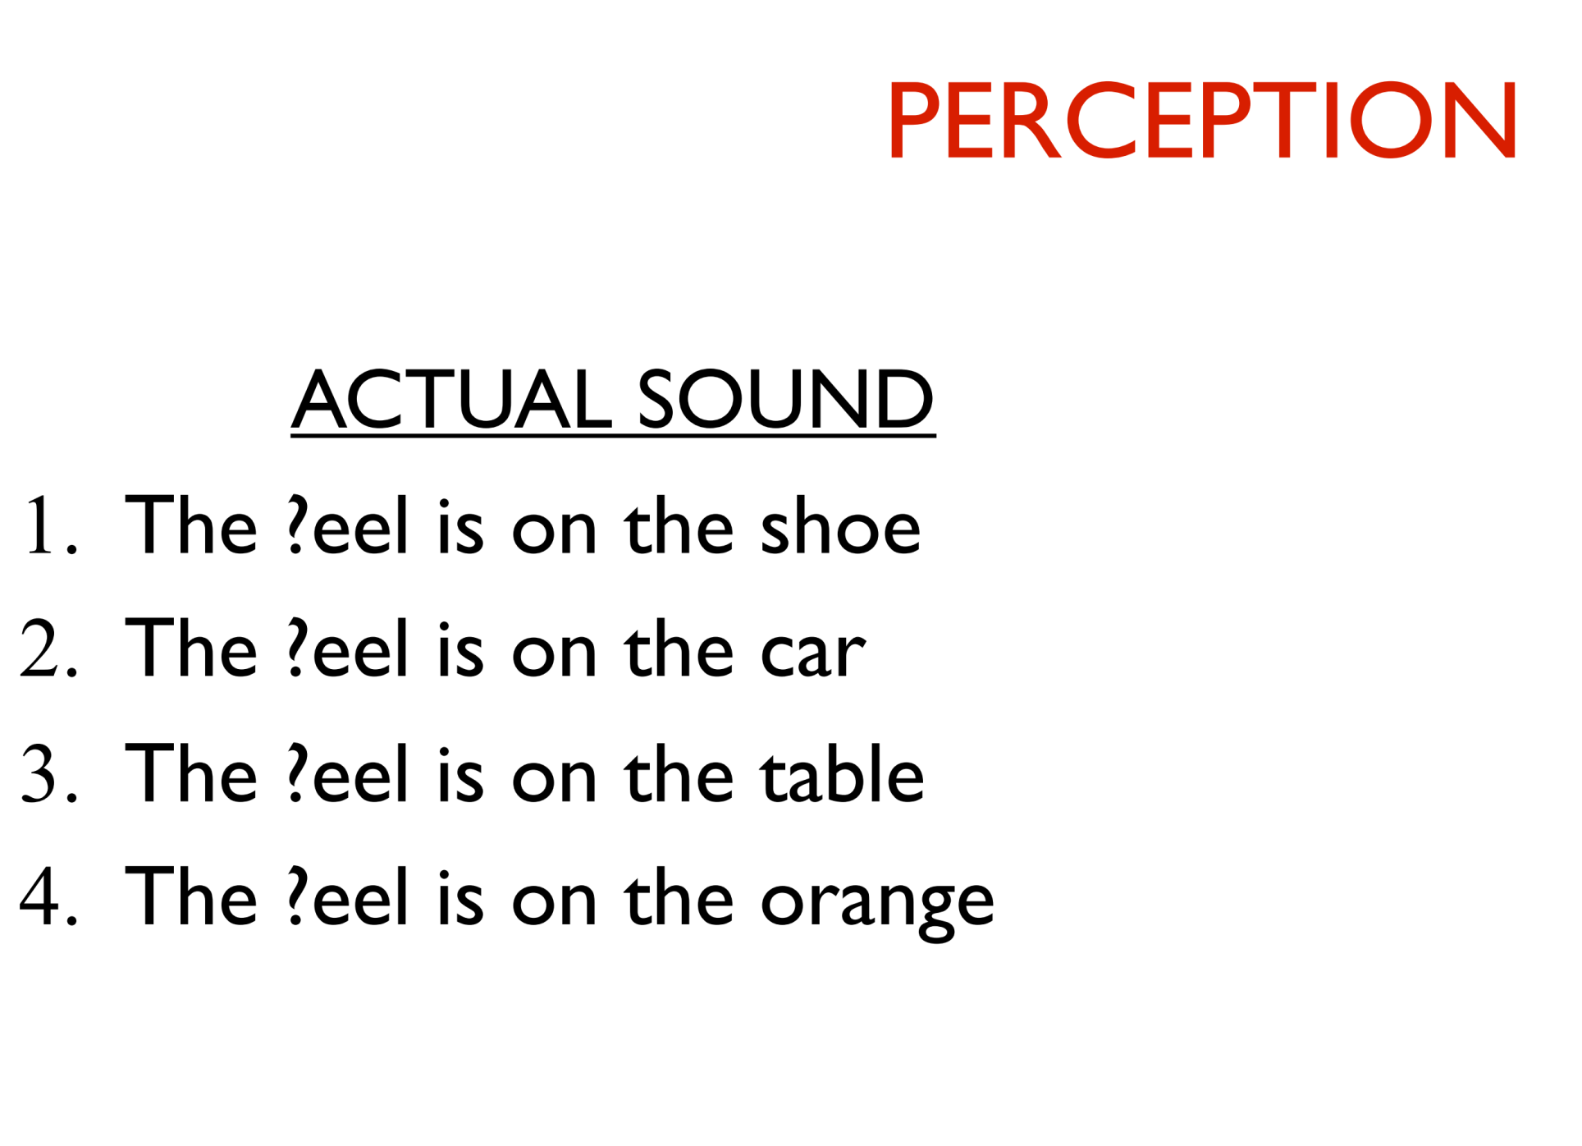

Slide 3
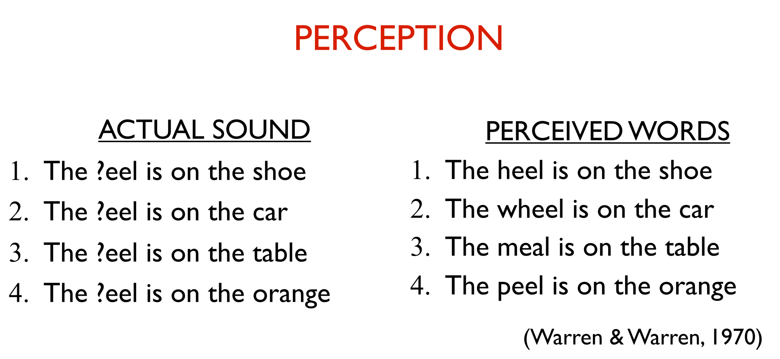

Slide 4
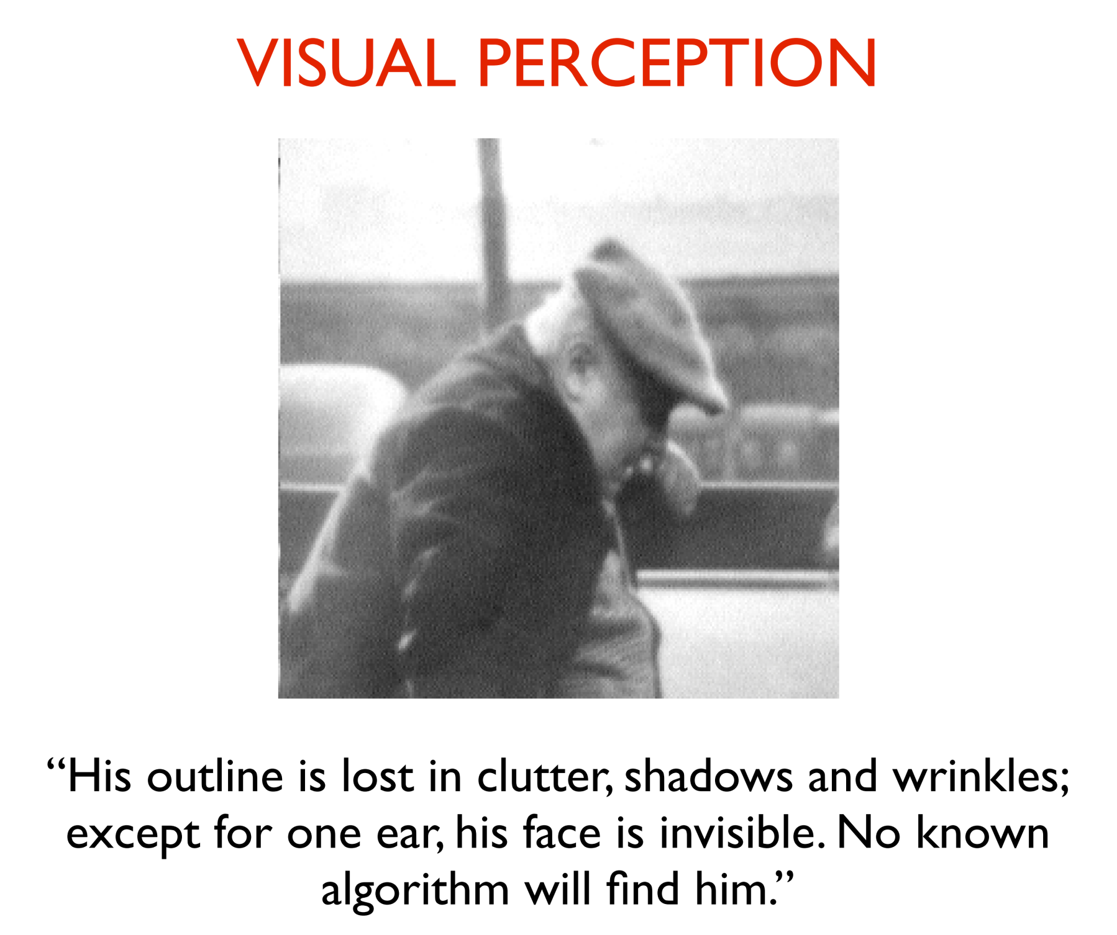

Slide 5
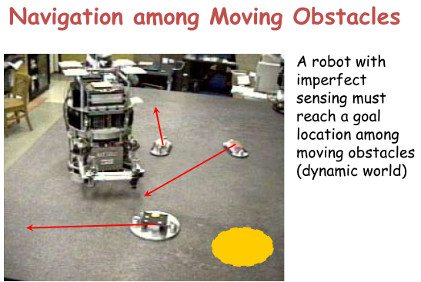

Slide 6
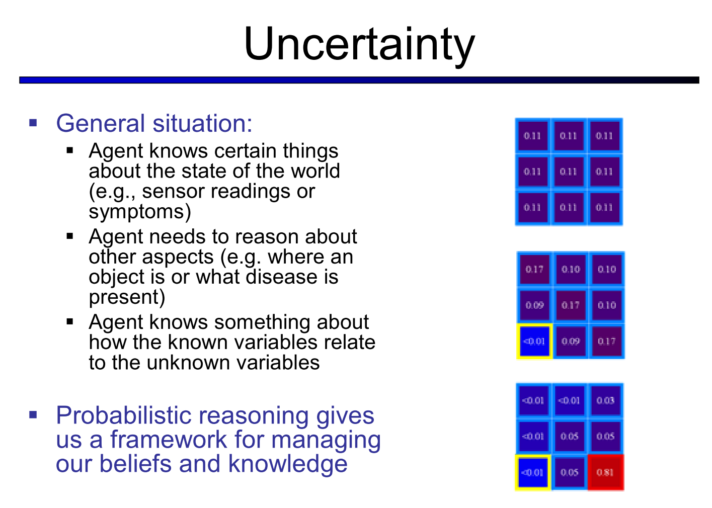

Slide 7
Uncertain Agent
sensors
?
?
environment
?
agent
?
actuators
model

Slide 8
Types of Uncertainty
Uncertainty in prior knowledge
E.g., some causes of a disease are unknown and are not represented in the background knowledge of a medical-assistant agent

Slide 9
Types of Uncertainty
For example, to drive my car in the morning:
It must not have been stolen during the night
It must not have flat tires
There must be gas in the tank
The battery must not be dead
The ignition must work
I must not have lost the car keys
No truck should obstruct the driveway
I must not have suddenly become blind or paralytic(中風)
etc…
Not only would it not be possible to list all of them, but would trying to do so be efficient?
Uncertainty in prior knowledge E.g., some causes of a disease are unknown and are not represented in the background knowledge of a medical-assistant agent
Uncertainty in actions E.g., actions are represented with relatively short lists of preconditions, while these lists are in fact arbitrary long

Slide 10
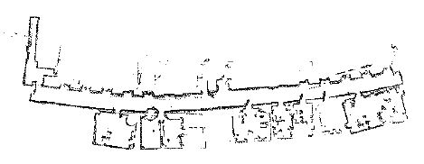
Types of Uncertainty
Uncertainty in prior knowledge E.g., some causes of a disease are unknown and are not represented in the background knowledge of a medical-assistant agent
Uncertainty in actions E.g., actions are represented with relatively short lists of preconditions, while these lists are in fact arbitrary long
Uncertainty in perception E.g., sensors do not return exact or complete information about the world; a robot never knows exactly its position
Courtesy R. Chatila

Slide 11
Types of Uncertainty
Uncertainty in prior knowledge E.g., some causes of a disease are unknown and are not represented in the background knowledge of a medical-assistant agent
Uncertainty in actions E.g., actions are represented with relatively short lists of preconditions, while these lists are in fact arbitrary long
Uncertainty in perception E.g., sensors do not return exact or complete information about the world; a robot never knows exactly its position
Sources of uncertainty:
Ignorance
Laziness (efficiency?)
What we call uncertainty is a summary of all that is not explicitly taken into account in the agent’s KB

Slide 12
Questions
How to represent uncertainty in knowledge?
How to perform inferences with uncertain knowledge?
Which action to choose under uncertainty?

Slide 13
How do we deal with uncertainty?
Implicit:
Ignore what you are uncertain of when you can
Build procedures that are robust to uncertainty
Explicit:
Build a model of the world that describe uncertainty about its state, dynamics, and observations
Reason about the effect of actions given the model

Slide 14
Handling Uncertainty
Approaches:
Default reasoning
Worst-case reasoning
Probabilistic reasoning

Slide 15
Default Reasoning
Creed(信條): The world is fairly normal. Abnormalities are rare
So, an agent assumes normality, until there is evidence of the contrary
E.g., if an agent sees a bird x, it assumes that x can fly, unless it has evidence that x is a penguin, an ostrich, a dead bird, a bird with broken wings, …

Slide 16
Representation in Logic
BIRD(x) ∧ ¬AB_{F}(x) ⇒ FLIES(x)
PENGUINS(x) ⇒ AB_{F}(x)
BROKEN-WINGS(x) ⇒ AB_{F}(x)
BIRD(Tweety)
…
Very active research field in the 80’s
→ Non-monotonic logics: defaults, circumscription(界限),
closed-world assumptions
Applications to databases
Default rule: Unless AB_{F}(Tweety) can be proven True, assume it is False
But what to do if several defaults are contradictory?
Which ones to keep? Which one to reject?

Slide 17
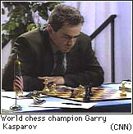
Worst-Case Reasoning
Creed: Just the opposite! The world is ruled by Murphy’s Law
Uncertainty is defined by sets, e.g., the set of possible outcomes of an action, the set of possible positions of a robot
The agent assumes the worst case, and chooses the actions that maximizes a utility function in this case
Example: Adversarial search

Slide 18
Probabilistic Reasoning
Creed: The world is not divided between “normal” and “abnormal”, nor is it adversarial. Possible situations have various likelihoods (probabilities)
The agent has probabilistic beliefs – pieces of knowledge with associated probabilities (strengths) – and chooses its actions to maximize the expected value of some utility function

Slide 19
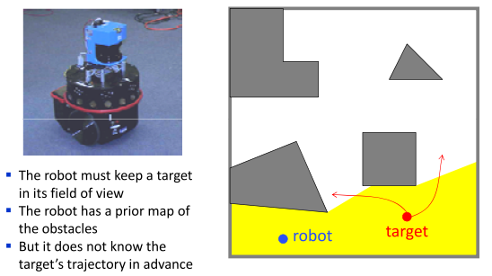
Target Tracking Example
Maximization of worst-case value of utility vs. of expected value of utility

Slide 20
How do we represent Uncertainty?
We need to answer several questions:
What do we represent & how we represent it?
What language do we use to represent our uncertainty? What are the semantics of our representation?
What can we do with the representations?
What queries can be answered? How do we answer them?
How do we construct a representation?
Can we ask an expert? Can we learn from data?

Slide 21
Probability
A well-known and well-understood framework for uncertainty
Clear semantics
Provides principled answers for:
Combining evidence
Predictive & Diagnostic reasoning
Incorporation of new evidence
Intuitive (at some level) to human experts
Can be learned

Slide 22
Notion of Probability
P(Av¬A) = P(A)+P(¬A)-P(A ∧¬A)
P(True) = P(A)+P(¬A)-P(False)
1 = P(A) + P(¬A) So:
P(A) = 1 - P(¬A)
You drive on Rt 1 to UMD often, and you notice that 70% of the times there is a traffic slowdown at the intersection of PaintBranch & Rt 1.
The next time you plan to drive on Rt 1, you will believe that the proposition “there is a slowdown at the intersection of PB & Rt 1” is True with probability 0.7
The probability of a proposition A is a real number P(A) between 0 and 1
P(True) = 1 and P(False) = 0
P(AvB) = P(A) + P(B) - P(A∧B)
Axioms of probability

Slide 23
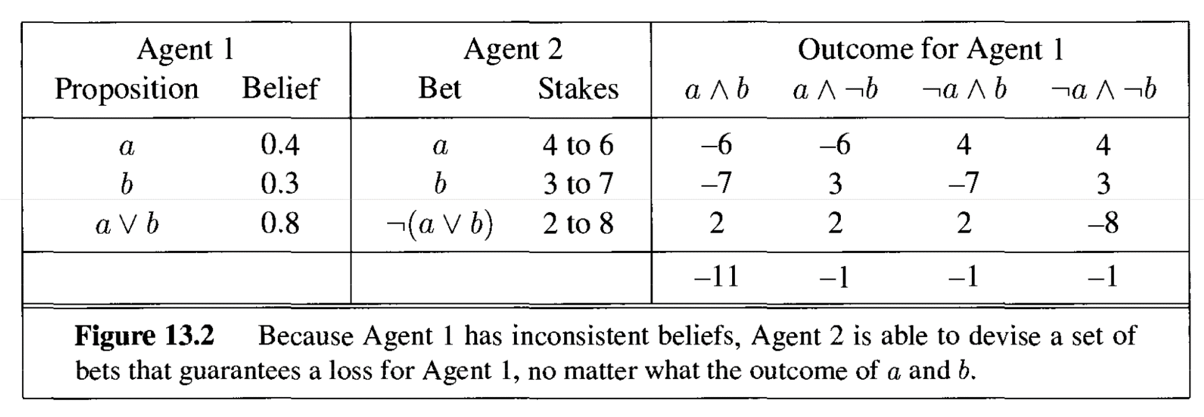
Why the axioms of probability are reasonable

Slide 24
Frequency Interpretation
Draw a ball from a urn containing n balls of the same size, r red and s yellow.
The probability that the proposition A = “the ball is red” is true corresponds to the relative frequency with which we expect to draw a red ball → P(A) = ?

Slide 25
Subjective Interpretation
There are many situations in which there is no objective frequency interpretation:
On a windy day, just before paragliding(高崖跳傘) from the top of El Capitan, you say “there is probability 0.05 that I am going to die”
You have worked hard on your AI class and you believe that the probability that you will get an A is 0.9

Slide 26
Bayesian Viewpoint
probability is "degree-of-belief", or "degree-of-uncertainty".
To the Bayesian, probability lies subjectively in the mind, and can--with validity--be different for people with different information
e.g., the probability that Wayne will get rich from selling his kidney.
In contrast, to the frequentist, probability lies objectively in the external world.
The Bayesian viewpoint has been gaining popularity in the past decade, largely due to the increase computational power that makes many of the calculations that were previously intractable, feasible.

Slide 27
Random Variables
A proposition that takes the value True with probability p and False with probability 1-p is a random variable with distribution (p,1-p)
If a urn contains balls having 3 possible colors – red, yellow, and blue – the color of a ball picked at random from the bag is a random variable with 3 possible values
The (probability) distribution of a random variable X with n values x₁, x₂, …, x_{n} is: (p₁, p₂, …, p_{n}) with P(X=x_{i}) = p_{i} and Σ_{i=1,…,n} p_{i} = 1

Slide 28
Expected Value
Random variable X with n values x₁,…,x_{n} and distribution (p₁,…,p_{n}) E.g.: X is the state reached after doing an action A under uncertainty
Function U of X E.g., U is the utility of a state
The expected value of U after doing A is E[U] = Σ_{i=1,…,n} p_{i} U(x_{i})

Slide 29
Joint Distribution
k random variables X₁, …, X_{k}
The joint distribution of these variables is a table in which each entry gives the probability of one combination of values of X₁, …, X_{k}
Example:
 | Toothache | ¬Toothache
Cavity | 0.04 | 0.06
¬Cavity | 0.01 | 0.89
P(¬Cavity∧Toothache)
P(Cavity∧¬Toothache)

Slide 30
Joint Distribution Says It All
 | Toothache | ¬Toothache
Cavity | 0.04 | 0.06
¬Cavity | 0.01 | 0.89
P(Toothache) = P((Toothache ∧Cavity) v (Toothache∧¬Cavity))
= P(Toothache ∧Cavity) + P(Toothache∧¬Cavity)
= 0.04 + 0.01 = 0.05
P(Toothache v Cavity) = P((Toothache ∧Cavity) v (Toothache∧¬Cavity) v (¬Toothache ∧Cavity)) = 0.04 + 0.01 + 0.06 = 0.11

Slide 31
Joint Distribution Says It All
 | Toothache | ¬Toothache
Cavity | 0.04 | 0.06
¬Cavity | 0.01 | 0.89
P(Toothache) = ??
P(Toothache v Cavity) = ??

Slide 32
Conditional Probability
Definition: P(A|B) =P(A∧B) / P(B)
Read P(A|B): probability of A given B
can also write this as: P(A∧B) = P(A|B) P(B)
called the product rule

Slide 33
Example
 | Toothache | ¬Toothache
Cavity | 0.04 | 0.06
¬Cavity | 0.01 | 0.89
P(Cavity|Toothache) = P(Cavity∧Toothache) / P(Toothache)
P(Cavity∧Toothache) = ?
P(Toothache) = ?
P(Cavity|Toothache) = 0.04/0.05 = 0.8

Slide 34
Generalization
P(A ∧ B ∧ C) = P(A|B,C) P(B|C) P(C)

Slide 35
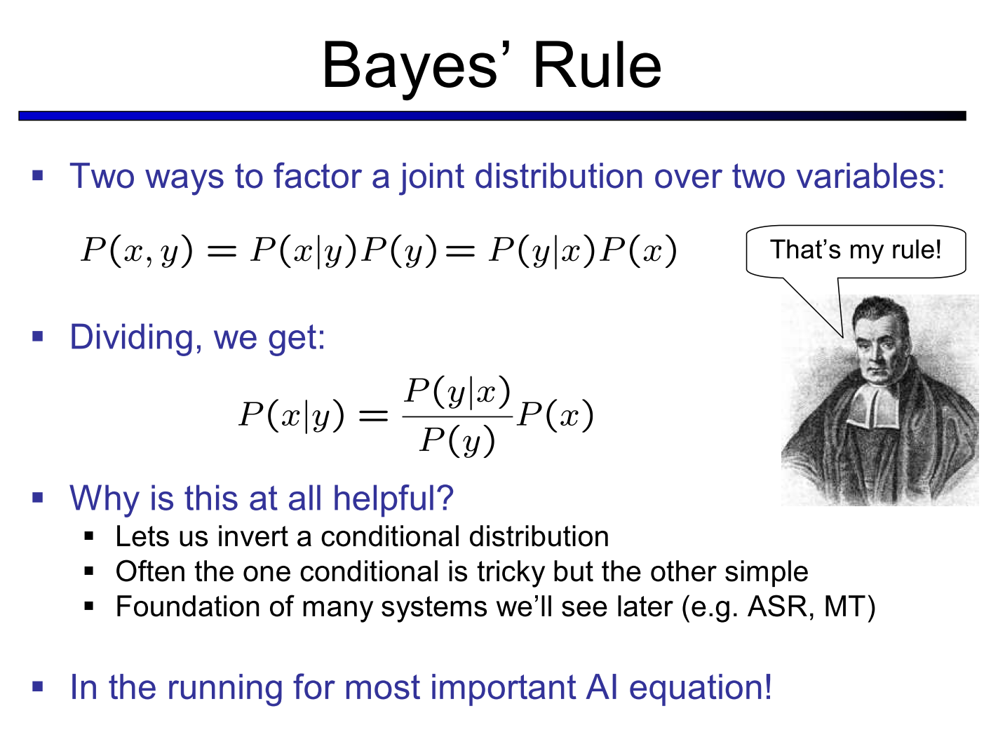

Slide 36
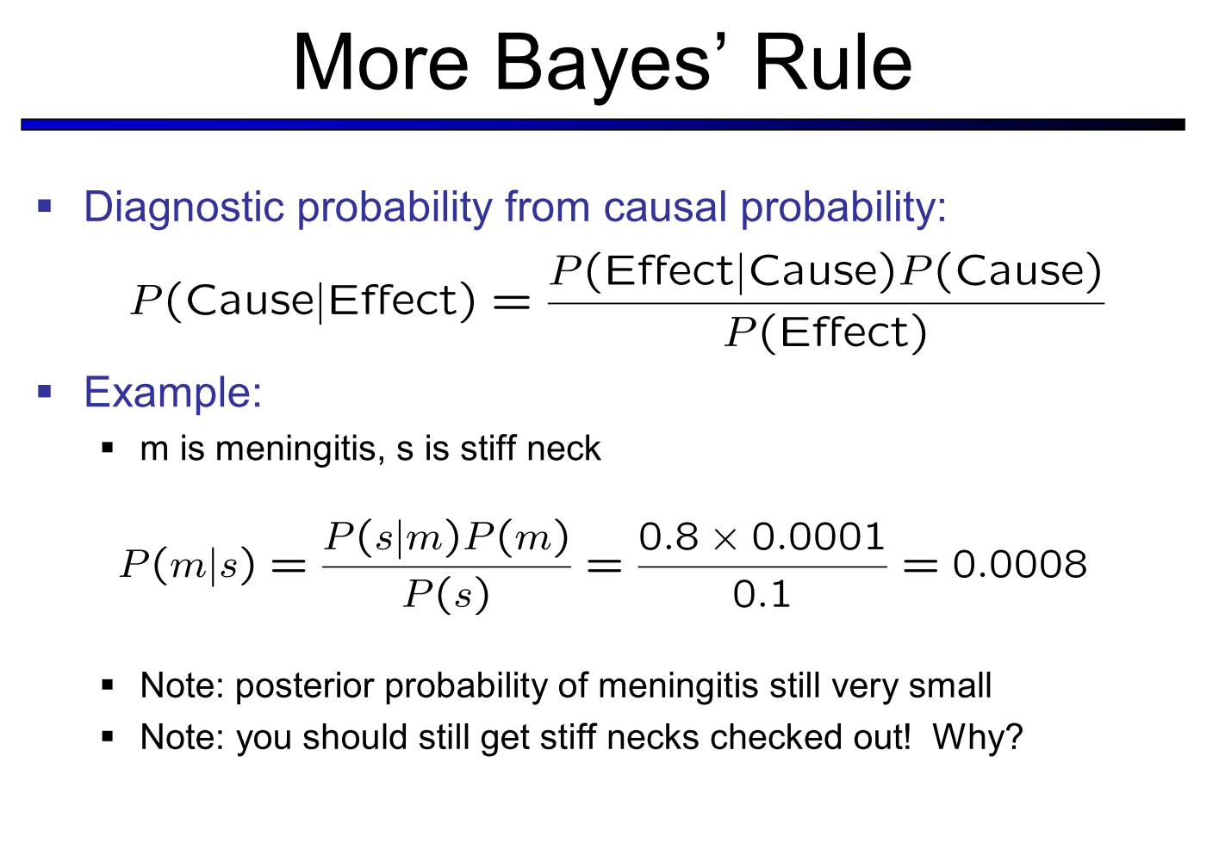
腦膜炎

Slide 37
Example
 | Toothache | ¬Toothache
Cavity | 0.04 | 0.06
¬Cavity | 0.01 | 0.89
Given:
P(Cavity)=0.1
P(Toothache)=0.05
P(Cavity|Toothache)=0.8
Bayes’ rule tells:
P(Toothache|Cavity)=(0.8x0.05)/0.1
=0.4

Slide 38
Generalization
P(A∧B∧C) = P(A∧B|C) P(C) = P(A|B,C) P(B|C) P(C)
P(A∧B∧C) = P(A∧B|C) P(C) = P(B|A,C) P(A|C) P(C)
P(A|B,C) P(B|C)
P(B|A,C) =
P(A|C)

Slide 39
Representing Probability
Naïve representations of probability run into problems.
Example:
Patients in hospital are described by several attributes:
Background: age, gender, history of diseases, …
Symptoms: fever, blood pressure, headache, …
Diseases: pneumonia, heart attack, …
A probability distribution needs to assign a number to each combination of values of these attributes
20 attributes require 10⁶ numbers
Real examples usually involve hundreds of attributes

Slide 40
Practical Representation
Key idea -- exploit regularities
Here we focus on exploiting (conditional) independence properties

Slide 41
Example
customer purchases: Bread, Bagels(麵包圈) and Butter (R,A,U)
Bread | Bagels | Butter | p(r,a,u)
0 | 0 | 0 | 0.24
0 | 0 | 1 | 0.06
0 | 1 | 0 | 0.12
0 | 1 | 1 | 0.08
1 | 0 | 0 | 0.12
1 | 0 | 1 | 0.18
1 | 1 | 0 | 0.04
1 | 1 | 1 | 0.16

Slide 42
Independent Random Variables
Two variables X and Y are independent if
P(X = x|Y = y) = P(X = x) for all values x,y
That is, learning the values of Y does not change prediction of X
If X and Y are independent then
P(X,Y) = P(X|Y)P(Y) = P(X)P(Y)
In general, if X₁,…,X_{n} are independent, then
P(X₁,…,X_{n})= P(X₁)...P(X_{n})
Requires O(n) parameters

Slide 43
Example #1
Butter | p(u)
0 | 0.52
1 | 0.48
Bread | Bagels | Butter | p(r,a,u)
0 | 0 | 0 | 0.24
0 | 0 | 1 | 0.06
0 | 1 | 0 | 0.12
0 | 1 | 1 | 0.08
1 | 0 | 0 | 0.12
1 | 0 | 1 | 0.18
1 | 1 | 0 | 0.04
1 | 1 | 1 | 0.16
Bagels | p(a)
0 | 0.6
1 | 0.4
Bread | p(r)
0
1
Bagels | Butter | p(a,u)
0 | 0
0 | 1
1 | 0
1 | 1
Bread | Bagels | p(r,a)
0 | 0
0 | 1
1 | 0
1 | 1
P(a,u)=P(a)P(u)?
P(r,a)=P(r)P(a)?

Slide 44
Example #1
Butter | p(u)
0 | 0.52
1 | 0.48
Bread | Bagels | Butter | p(r,a,u)
0 | 0 | 0 | 0.24
0 | 0 | 1 | 0.06
0 | 1 | 0 | 0.12
0 | 1 | 1 | 0.08
1 | 0 | 0 | 0.12
1 | 0 | 1 | 0.18
1 | 1 | 0 | 0.04
1 | 1 | 1 | 0.16
Bagels | p(a)
0 | 0.6
1 | 0.4
Bread | p(r)
0 | 0.5
1 | 0.5
Bagels | Butter | p(a,u)
0 | 0 | 0.36
0 | 1 | 0.24
1 | 0 | 0.16
1 | 1 | 0.24
Bread | Bagels | p(r,a)
0 | 0 | 0.3
0 | 1 | 0.2
1 | 0 | 0.3
1 | 1 | 0.2
P(a,u)=P(a)P(u)?
P(r,a)=P(r)P(a)?

Slide 45
Conditional Independence
Unfortunately, random variables of interest are not independent of each other
A more suitable notion is that of conditional independence
Two variables X and Y are conditionally independent given Z if
P(X = x|Y = y,Z=z) = P(X = x|Z=z) for all values x,y,z
That is, learning the values of Y does not change prediction of X once we know the value of Z
notation: I( X ; Y | Z )

Slide 46
Car Example
Three propositions:
Gas
Battery
Starts
P(Battery|Gas) = P(Battery) Gas and Battery are independent
P(Battery|Gas,Starts) ≠ P(Battery|Starts) Gas and Battery are not independent given Starts

Slide 47
Example #2
Hotdogs | Mustard | Ketchup | p(h,m,k)
0 | 0 | 0 | 0.576
0 | 0 | 1 | 0.144
0 | 1 | 0 | 0.064
0 | 1 | 1 | 0.016
1 | 0 | 0 | 0.004
1 | 0 | 1 | 0.036
1 | 1 | 0 | 0.016
1 | 1 | 1 | 0.144
Mustard | p(m)
0 | 0.76
1 | 0.24
Ketchup | p(k)
0 | 0.66
1 | 0.34
Mustard | Ketchup | p(m,k)
0 | 0 | 0.58
0 | 1 | 0.18
1 | 0 | 0.08
1 | 1 | 0.16
Mustard：芥末
Ketchup：番茄醬
P(m,k)=P(m)P(k)?

Slide 48
Example #2
H | M | K | p(h,m,k)
0 | 0 | 0 | 0.576
0 | 0 | 1 | 0.144
0 | 1 | 0 | 0.064
0 | 1 | 1 | 0.016
1 | 0 | 0 | 0.004
1 | 0 | 1 | 0.036
1 | 1 | 0 | 0.016
1 | 1 | 1 | 0.144
Mustard | Hotdogs | p(m|h)
0 | 0 | 0.9
0 | 1 | 0.2
1 | 0 | 0.1
1 | 1 | 0.8
Ketchup | Hotdogs | p(k|h)
0 | 0 | 0.8
0 | 1 | 0.1
1 | 0 | 0.2
1 | 1 | 0.9
Mustard | Ketchup | Hotdogs | p(m,k|h)
0 | 0 | 0 | 0.72
0 | 1 | 0 | 0.18
1 | 0 | 0 | 0.08
1 | 1 | 0 | 0.02
0 | 0 | 1 | 0.02
0 | 1 | 1 | 0.18
1 | 0 | 1 | 0.08
1 | 1 | 1 | 0.72
P(m,k|h)=P(m|h)P(k|h)?
P(X = x|Y = y,Z=z) = P(X = x|Z=z) for all values x,y,z

Slide 49
Example #1
Bread | Bagels | Butter | p(r,a,u)
0 | 0 | 0 | 0.24
0 | 0 | 1 | 0.06
0 | 1 | 0 | 0.12
0 | 1 | 1 | 0.08
1 | 0 | 0 | 0.12
1 | 0 | 1 | 0.18
1 | 1 | 0 | 0.04
1 | 1 | 1 | 0.16
Bread | Butter | p(r|u)
0 | 0 | 0.69…
0 | 1 | 0.29…
1 | 0 | 0.30…
1 | 1 | 0.70…
Bagels | Butter | p(a|u)
0 | 0 | 0.69…
0 | 1 | 0.5
1 | 0 | 0.30…
1 | 1 | 0.5
Bread | Bagels | Butter | p(r,a|u)
0 | 0 | 0 | 0.46…
0 | 1 | 0 | 0.23…
1 | 0 | 0 | 0.23…
1 | 1 | 0 | 0.08…
0 | 0 | 1 | 0.12…
0 | 1 | 1 | 0.17...
1 | 0 | 1 | 0,38…
1 | 1 | 1 | 0.33…
P(r,a|u)=P(r|u)P(a|u)?

Slide 50
Summary
Example 1: I(X,Y|∅) and not I(X,Y|Z)
Example 2: I(X,Y|Z) and not I(X,Y|∅)
conclusion: independence does not imply conditional independence!

Slide 51
Example: Naïve Bayes Model
A common model in early diagnosis:
Symptoms are conditionally independent given the disease (or fault)
Thus, if
X₁,…,X_{n} denote whether the symptoms exhibited by the patient (headache, high-fever, etc.) and
H denotes the hypothesis about the patients health
then, P(X₁,…,X_{n},H) = P(H)P(X₁|H)…P(X_{n}|H),
This naïve Bayesian model allows compact representation
It does embody strong independence assumptions

